Slide 1

GOKHALE INSTITUTE OF POLITICS AND ECONOMICS
BUSINESS ANALYTICS PROJECT
TOPIC: TELECOM CUSTOMER CHURN ANALYSIS
SPECIALIZATION: AGRIBUSINESS ECONOMICS
NAMES: 1] ADITYA JORI [ AE-2017 ]

Slide 2
PROBLEM STATEMENT
Our problem is based on the telecom customer churn prediction of a Telecom company which is trying to predict the customer behavior by considering various characteristics of the customers.
The Telecom industry has a strong presence across the country. India is the world’s second-largest telecommunications market globally.

Slide 3
DATASET DETAILS
Information about the Customer’s characteristics who use the telecom service.
15 highlighted features about clients
Numerical features: senior citizen, tenure, monthly charges, total charges (remaining are categorical)
7000 data samples in the dataset
Discontinue: value1
Continue: value 0

Slide 4
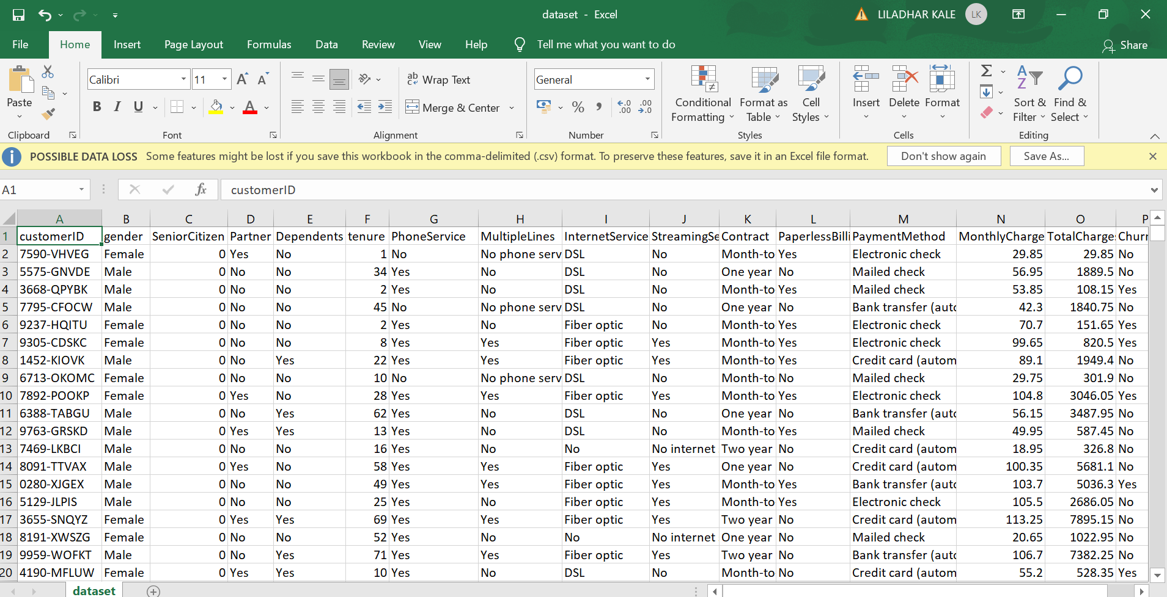
GOAL: To build an efficient and accurate Machine Learning Model using the Training dataset and precisely predict the customer churn on the Testing Dataset.

Slide 5
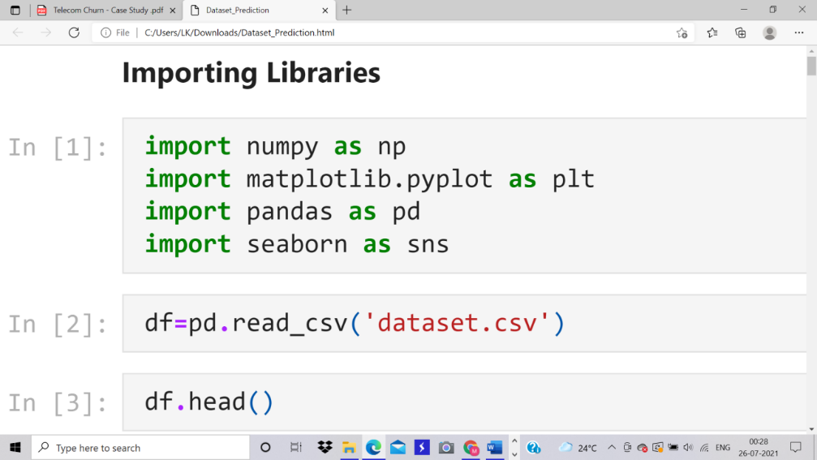
EXPLORATORY DATA ANALYSIS
IMPORTING LIBRARIES
Data Manipulation and Data Visualization:
Numpy, Panda, Matplotlib, Seaborn
Data processing and Feature extraction :
SciKit Learn
Machine Learning:
model Scikit Learn and XGBoost

Slide 6
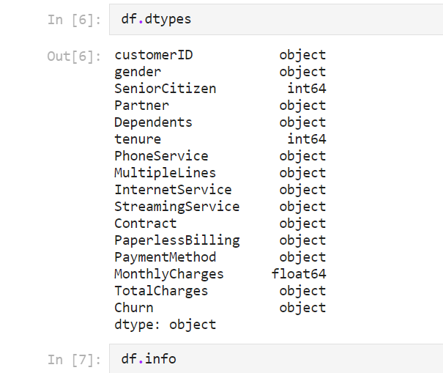
Integer Data type: Senior citizen, Tenure Float Data type: Monthly Charges Object type: All of the others The feature of Total Charges was found to be of Object type. But to successfully run the ML Model, it is necessary to convert it to Float type of data.

Slide 7
STATISTICAL OPERATIONS:
Graphs for visualization and relation of variables
HISTOGRAM:
Churn= (0,1)
Applied for each feature to analyse the depth

Slide 8
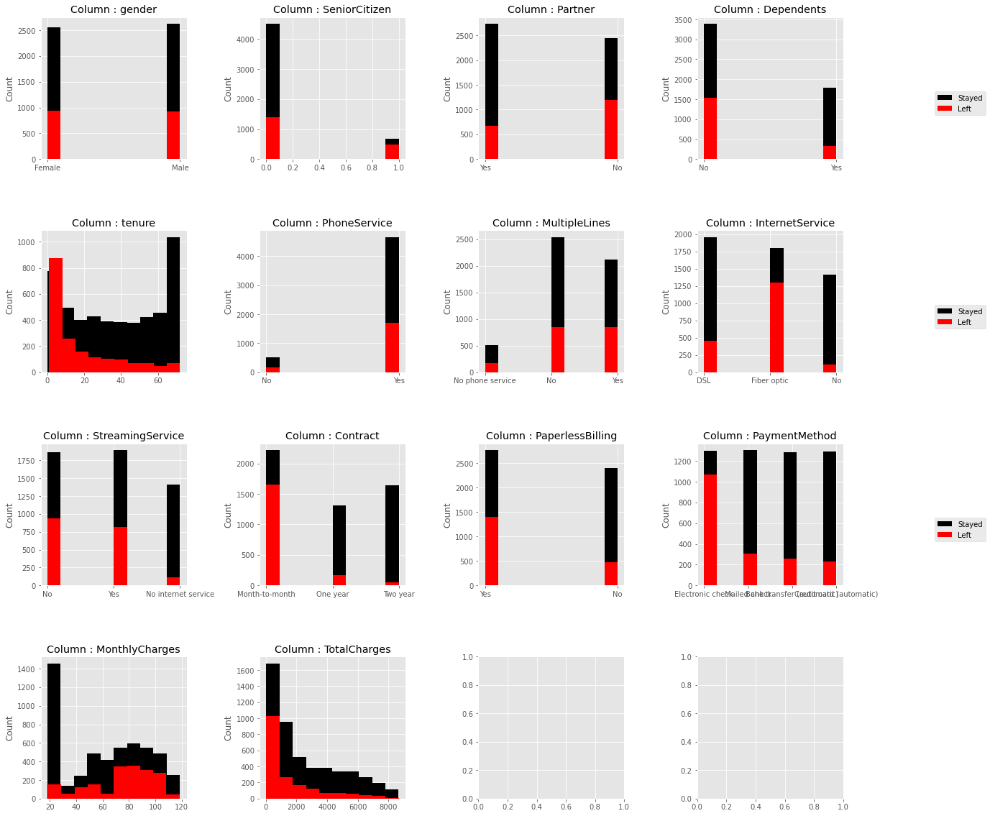
HISTOGRAM:

Slide 9
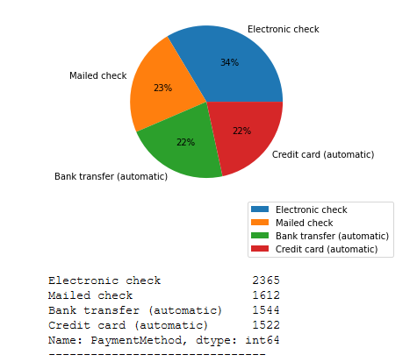
PIE CHART :
Most used method of payment is electronic check
Electronic check=mode
(mode is used for categorical features as mean is not calculatable)

Slide 10
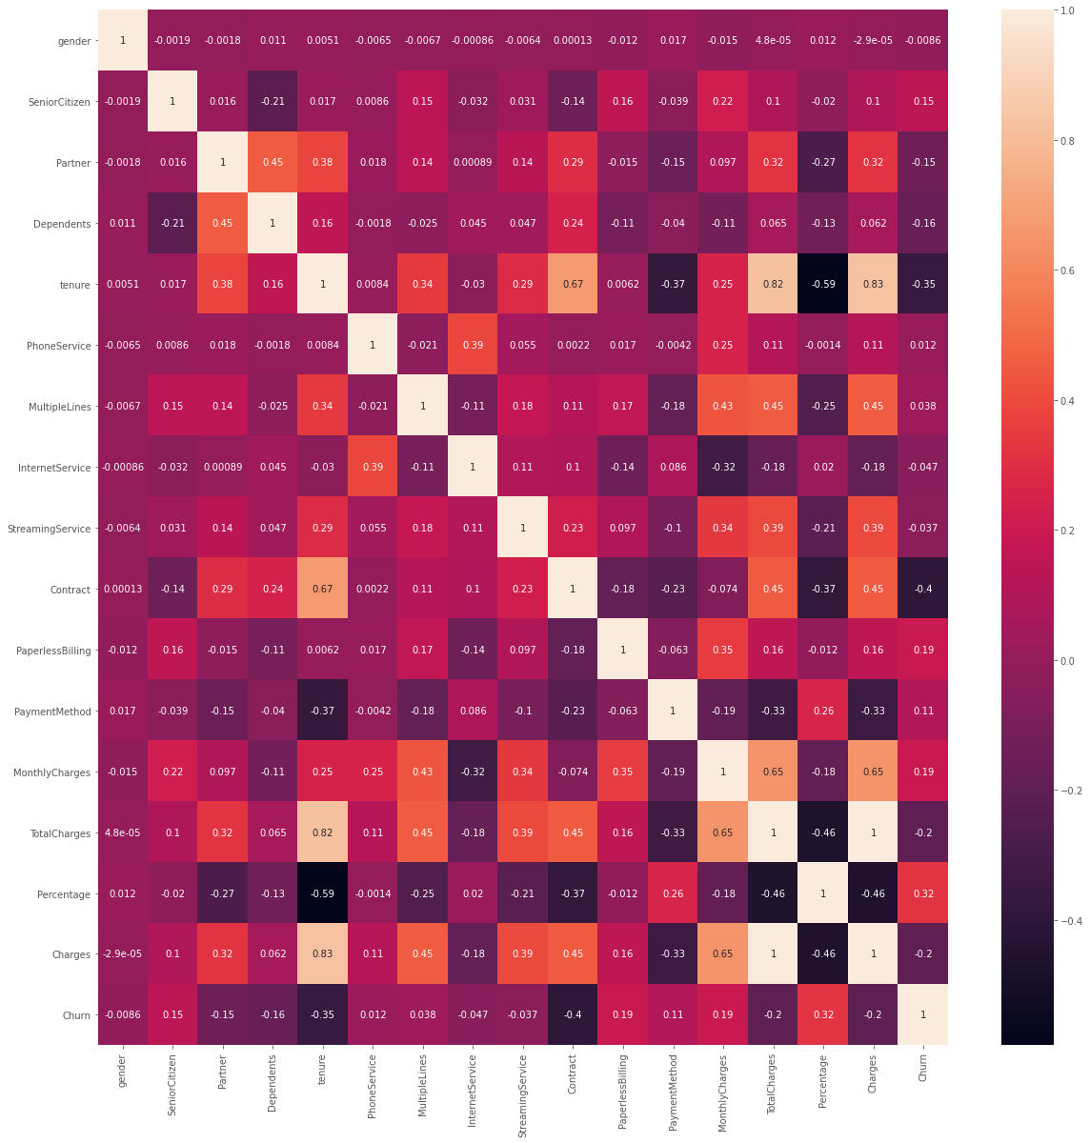
HEAT MAP: Correlation coefficient between two features 1. Highly correlated features = no new information 2. Good features = reasonably high correlation

Slide 11
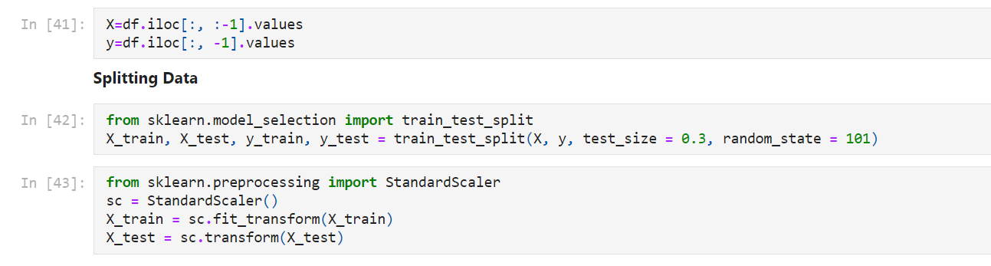
SPLITTING THE DATA:
1. Training data:(size =0.7)
70% of data will be trained
2. Testing data:(size=0.3)
30% data will be tested

Slide 12
FEATURE SCALING:
Removing redundant variable.
Churn= only dependent variable
Churn stored in Y variable for easier model building
Feature scaling for same range
String data -> integer data
(Gender Feature: Male- 1, Female- 0)

Slide 13
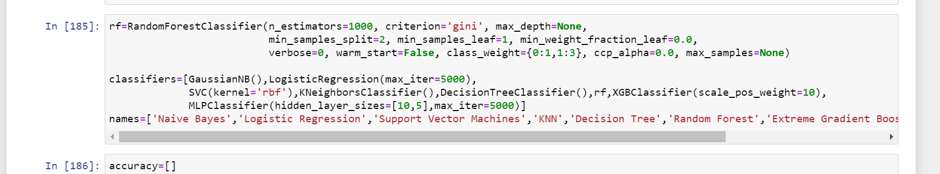
MACHINE LEARNING MODELS
Random Forest Classifier
Large number of individual decision trees that operate as an ensemble
Low correlation
SYNTAX :

Slide 14
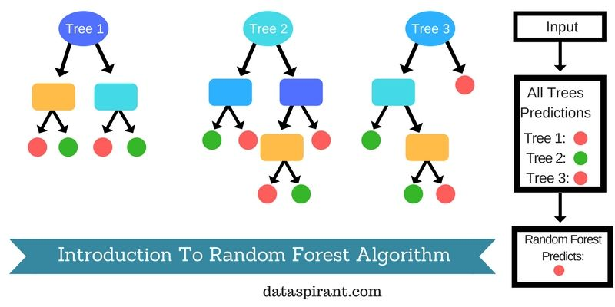
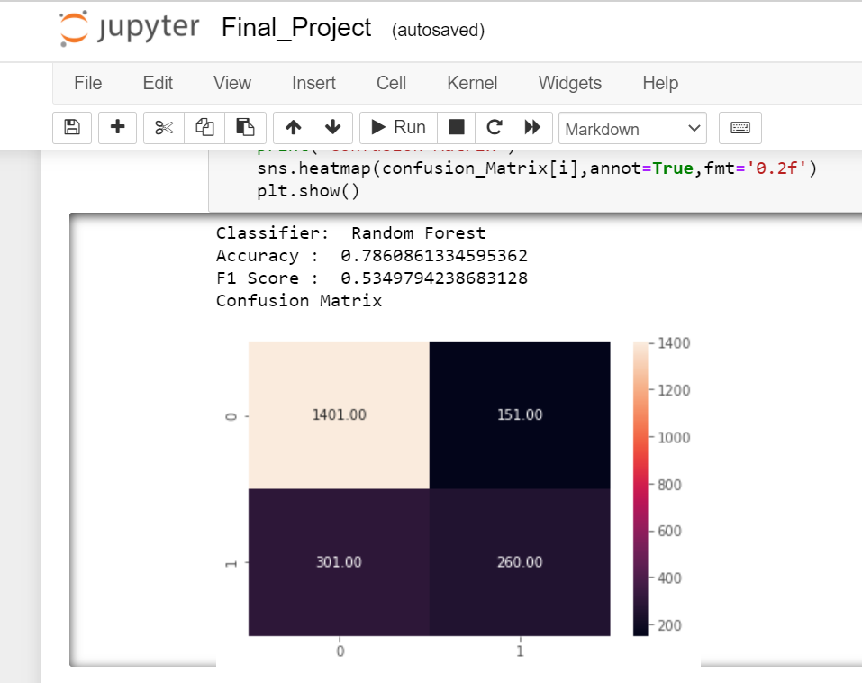
RANDOM FOREST CLASSIFIER :

Slide 15
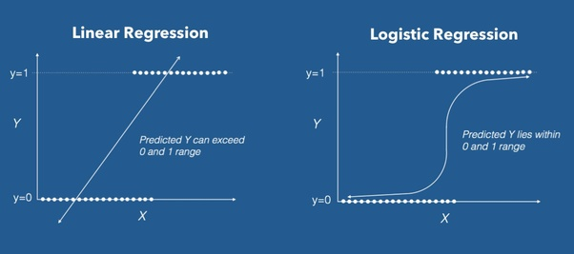
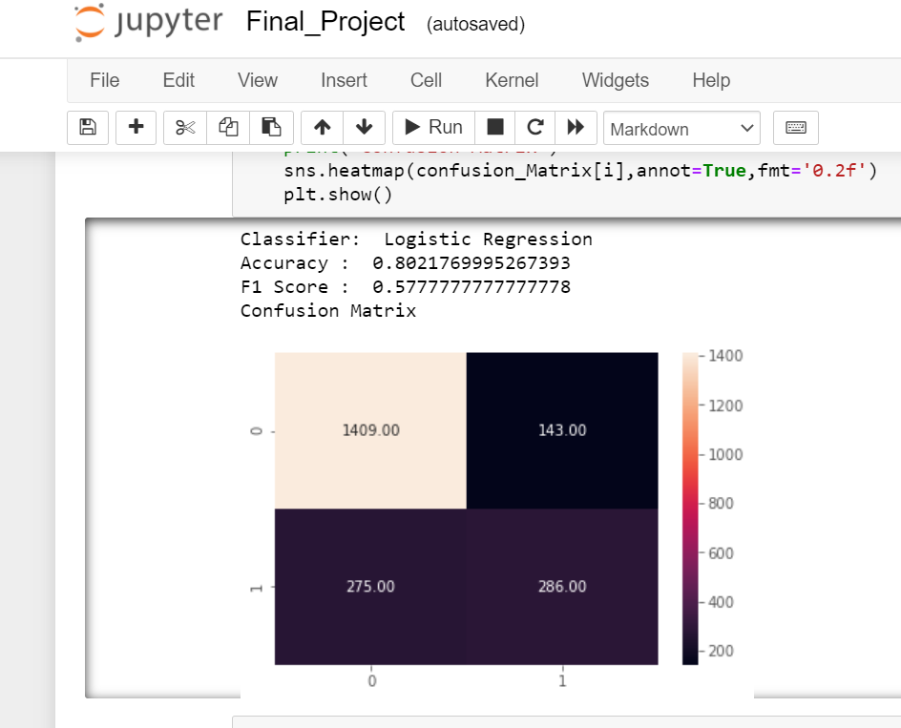
Logistic Regression Model Dependent variable is binary (data coded as 1 or 0) P(Y=1) = f(X)

Slide 16
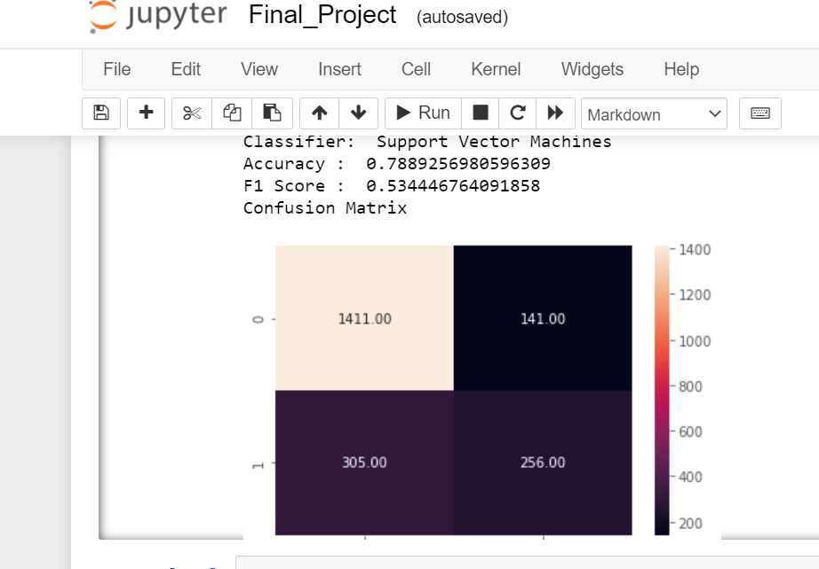

Support Vector Classifier Classification and regression challenges Value of each feature is the value of a particular coordinate. attributes :‘n-estimators', 'criterion', 'random state'

Slide 17
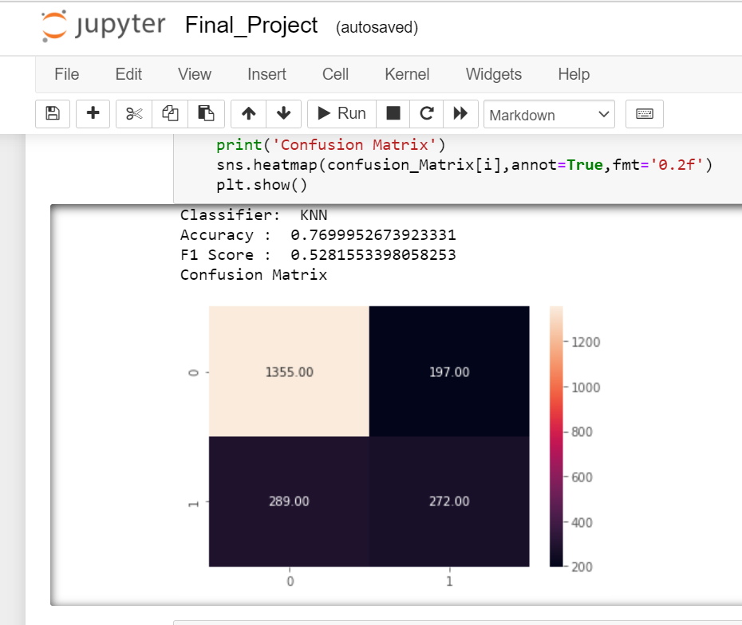
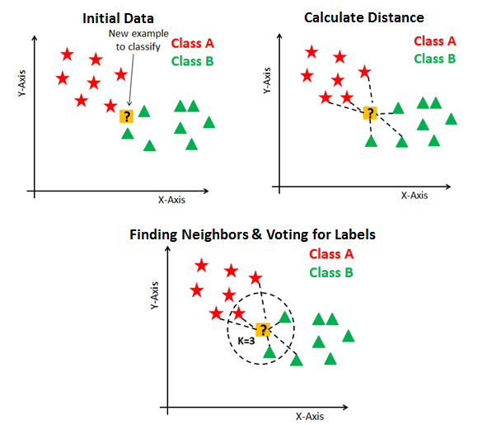
K-Nearest Neighbors Classifier Euclidean method ascending order of distance values top K value most frequent class in above K value

Slide 18
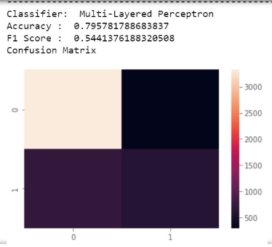
MLP Classifier:
Connects to neural network
Generates set of outputs from set of inputs
Input nodes connected as a graph
Back propagation for training

Slide 19
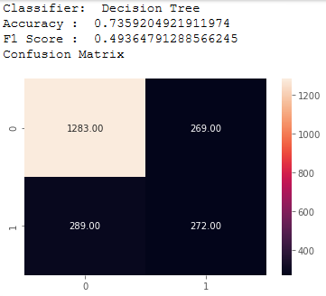
Decision Tree Classifier:
The model uses a decision tree (as a predictive model) to go from observations about an item (represented in the branches) to conclusions about the item's target value (represented in the leaves).
Tree models where the target variable can take a discrete set of values are called classification trees.
The leaves represent class labels and branches represent conjunctions of features that lead to those class labels.
Decision trees are among the most popular machine learning algorithms given their intelligibility and simplicity.

Slide 20
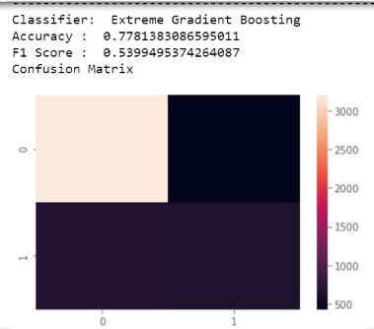
XGB Classifier:
Gradient decent algorithm
Minimise loss
Regression and Classification predictive modelling problems
Unstructured data

Slide 21
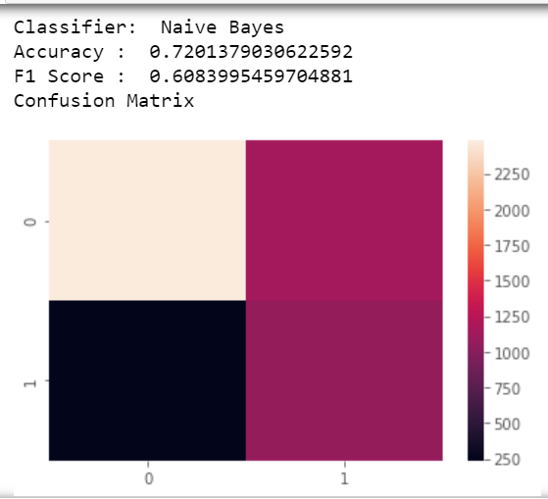
NAÏVE BAYES:
Simple and effective
Probablistic classifier
Family of algorithms where every pair of
features being classified are
independent of eachother

Slide 22
RESULTS :
 | CLASSIFIER | ACCURACY | F1_SCORE
1 | Naive Bayes | 0.7434926644581165 | 0.6150568181818181
2 | Logistic Regression | 0.8021769995267393 | 0.5777777777777778
3 | Support Vector Machine | 0.7889256980596309 | 0.534446764091858
4 | Decision Tree | 0.7359204921911974 | 0.49364791288566245
5 | K Nearest Neighbours | 0.7699952673923331 | 0.5281553398058253
6 | Random Forest Classifier | 0.7860861334595362 | 0.5349794238683128
7 | MLP Classifier | 0.7969711310932324 | 0.5671039354187689
8 | XGBoost Classifier | 0.7444391859914813 | 0.6041055718475073

Slide 23
CONCLUSION :
Small and is unbalanced
Pandas Profiling Report shows various correlation coefficients and acts as good starting point for the EDA
Logistic Regression Model: most reliable: high accuracy, reasonably high F1 score
XGB and Naïve Bayes: Best F1 score but cannot exceed the 75% accuracy mark
Feature scaling: Training SVM Otherwise, 0 F1 score.
Increasing accuracy: SMOTE – Hyperparameter tuning – Cross Validation
An ensemble of the top four classifiers might perform better as well
Best achieved by Logistic Regression Model
Prioritizing customer retention

